Slide 1

Summer Internship AUGMENTED REALITY MOBILE APPLICATION TOURISTIC GUIDE Host Organisme
Presented by
MAALEJ YESSINE
Supervised by
M. MEHDI MOHAMED
DATE : Wednesday ,December 20th 2013
Notes:
Ladies ,
Hello and thank you so much for having me I’m delighted to be here and so happy to share with you the presentation of my summer internship
I want to begin by thinking you for accepting to evaluate the report and the presentaation of my intership that i’ve made during the last summer.
I also thank Mr Mohamed Mahdi , my supervisor in cynapsys
I know that today’s topic may bring up a number of questions from you so I hope that you will adress as many as you want at the end of the presentation .

Slide 2
Summary
Overview
1
SOLUTIONS & TECHNOLOGIES
2
REQUIREMENTS ASSESSMENT
Summary
3
DESIGN
4
ACHIEVEMENTS
Wrap up
Notes:
To begin with I want to enumerate the summary of the presentation which contains a general overview concerning the hole internship , then I will move for describing the solutions and the technologies passing then to the requirements part for FR and Nfr and related Use-case diagram .
For the the application’s design , I will be talking about the hole architecture of the app then describing a general approach about packages diagram to talk then about the achievement part and so on to the Conclusion

Slide 3
OVERVIEW
Introduction of the company
Fields of expertise
Mobile cluster
CYNAPSYS
Developping an augmented reality mobile application to guide tourist by showing points of interest using an advanced concept .
SUBJECT
3
Notes:
The company is of German origin, its first site was established in Munchen. Then it expanded
its presence by setting up a second site in France. Through its two subsidiaries, Cynapsys
has developed a deep knowledge of the European market. The site of Tunis, the environment
where the internship was conducted, is the site of communication technology Elghazela and
has about 115 employees working on support staff, application and design.
1.3 Project Background
In this section, we present the project, subject of this internship by putting it in its general
concepts .
Stage report

Slide 4
OVERVIEW
Definition
History
How to use it
REALITY
AUGMENTED
Android
Much innovation in the mobile
AR space are happening
on Android , as the necessary hardware and API are available
os
S
4
Notes:
Augmented reality consist on adding additional information to reality , It means we gonna to identify our enviorement either by specific image recognition or with a geo based augmented concept.
It magnificent Idea that was made from the begining for military purposes , than expanded to be applied in many fields of our life .
So imagine for example that you’re visiting for the first time a country and that you don’t even know the exact information and location concerning hotels , restaurents , museum etc …
You are simply in front of hotel but you don’t know if there are vacaint rooms or not or you don’t have an idea about prices , special sevices and every thing .
For the operating systems turning on mobiles , we’ve decided to work on android as a test OS .

Slide 5
SOLUTIONS & TECHNOLOGIES
1
OVERVIEW
SOLUTIONS
TECHNOLOGIES
5
Notes:
This part is very important which concerns available API to work with and the eventuel configurations.

Slide 6

SOLUTIONS & TECHNOLOGIES
Wikitude
Rank
1st web browser engine in the world .
Performance
API available for Android, IOS and PhoneGap .
Evolution
8 APIs in two years .
Notes:
The principle API that we used was Wikitude , which is by the way
*1st web browser engine in the world .
*API available for Android, IOS and PhoneGap .
*This company realesed 8 API within 2 years

Slide 7

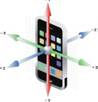
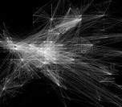
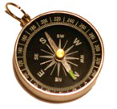
SOLUTIONS & TECHNOLOGIES
To present information about our surroundings (landmarks,
points of interest) annotated onto a live camera view , the smart phone should dispose of the following charateristics :
GPS
Accelerometer
How is my phone
oriented in the world?
Where am I ?
Internet
connectivity
To connect to
the digital world
Compass
In which direction
am I looking?
Notes:
GPS : Global Positioniing System : by using latitude , altitude and longitude for your position .
Accelometyer : by offering a triple axis for our phone to indicate how the phone was moved during our trip .
Compass : which position we have comparing the position of our phone comparing to the west

Slide 8
REQUIREMENTS ASSESMENTS
1
2
SOLUTIONS
OVERVIEW
TECHNOLOGIES
REQUIREMENS
ASSESMENTS

Slide 9
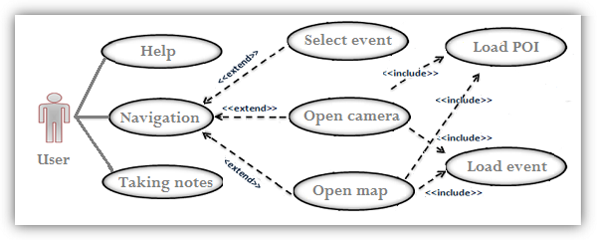
REQUIREMENTS ASSESMENTS
USE-CASE DIAGRAM :
Notes:
The following diagram discribes the possible fonctionnality that the application must offer .

Slide 10


REQUIREMENTS ASSESMENTS
Functional requirements :
The application must offer a live events calendar
The application should allow optimal
Research and show of all the POI in AR
The application must offer features
of each selected POI
The application have to refer back to all the events on map

Slide 11
REQUIREMENTS ASSESMENTS
Non functiona requirements :
Usability
Reability
Performance
Simplicity
Notes:
This application must satisfy a series of non-functional requirements such as :
Usability : The user should not have to spend more than 20 seconds to be able to see POI
loaded and displayed in the screen while the cam is opened.
Reliability : The application should, under normal conditions, perform the required functions
successfully.
The application must allow an easy choice of POI categories .
Performance :The application must offer maximum characteristic of each selected POI
without being very slow.

Slide 12
DESIGN
3
1
3
1
2
préalable
REQUIREMENT
choix techniques
SOLUTIONS
Etude
OVERVIEW
Solutions
ASSESMENTS
TECHNOLOGIES
ARCHITECTURE
DESIGN

Slide 13

DESIGN
Camera
Application
Screen
Filming the
real-time
environment
Analyzes the scene
Adds virtuel data
Combines the two
parts .
Shows live calendar
Dispaying the result containing reality
plus POIs markers.
Map view
Using phone
to film
Reality
+
restaurants
+
hotels
….

Slide 14
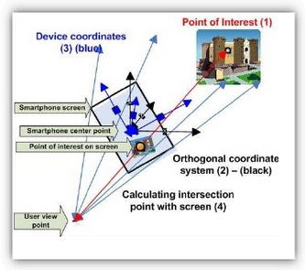
DESIGN
How markers of real POI are being displayed on screen ?
Notes:
So each phone equipped by an accelerometer

Slide 15
DESIGN
JSON :
Each server offering JSON objects presenting different POI s in Tunisia arranged in the same way as the following ones will be displayed in our activity .
[{"id":"1","longitude":"0.04","latitude":"0.089","description":"This is the description of POI#1","name":"POI#1"},
{"id":"2","longitude":"0.039","latitude":"0.093","description":"This is the description of POI#2","name":"POI#2"},
{"id":"3","longitude":"-0.042","latitude":"0.069","description":"This is the description of POI#3","name":"POI#3“}]
Notes:
JavaScript Object Notation : is a lightweight data-interchange format
It is easy for machines to parse and generate.
It is easy for humans to read and write

Slide 16
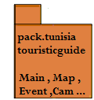
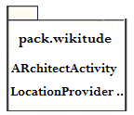




DESIGN

Slide 17
ACHIVEMENT
1
4
1
2
3
préalable
REQUIREMENTS
SOLUTION
Etude
OVERVIEW
TECHNOLOGIES
ASSESMENTS
DESIGN
ACHIEVEMENT
17

Slide 18
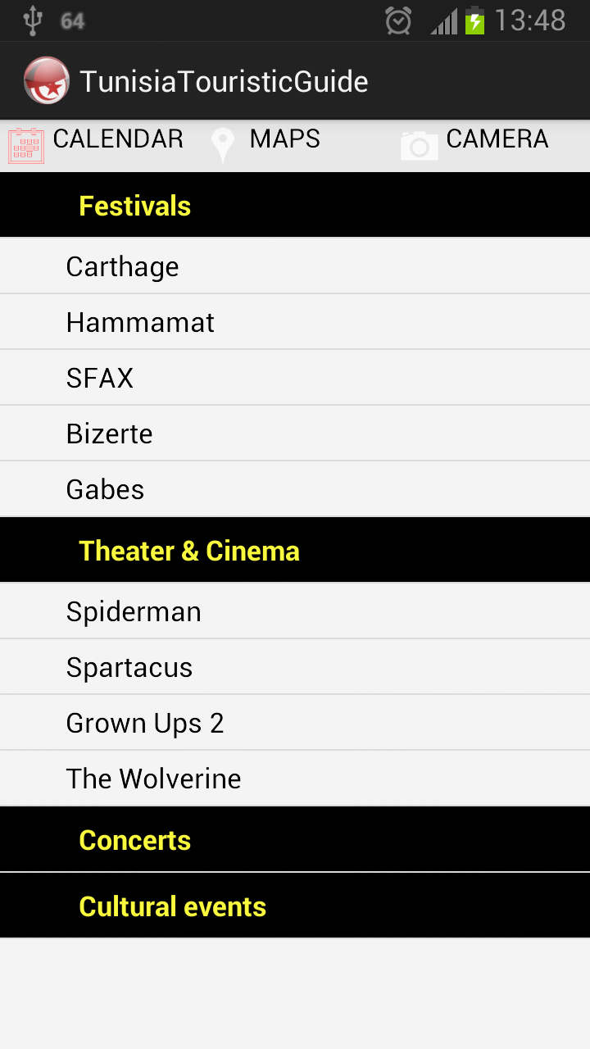
ACHIVEMENT
Notes:
So let me invite you , if you don’t mind , to have a look at the application running oh the phone

Slide 19
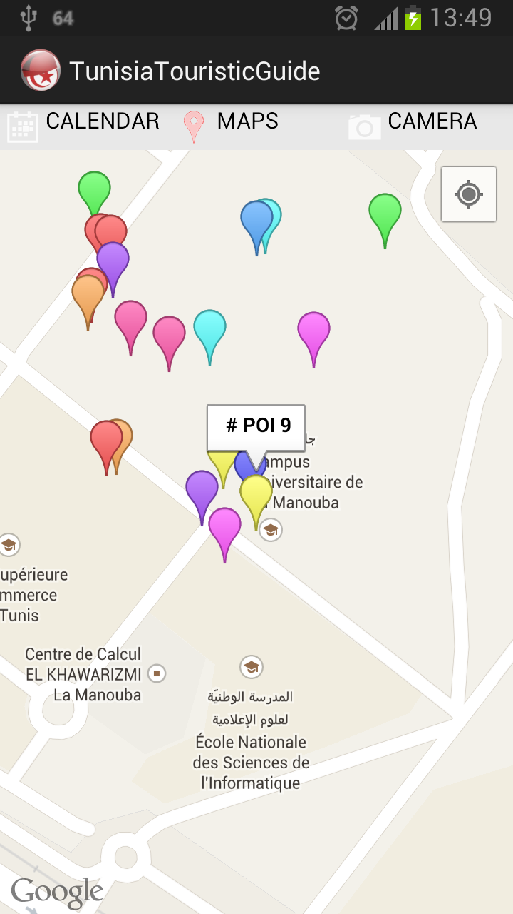
ACHIVEMENT

Slide 20
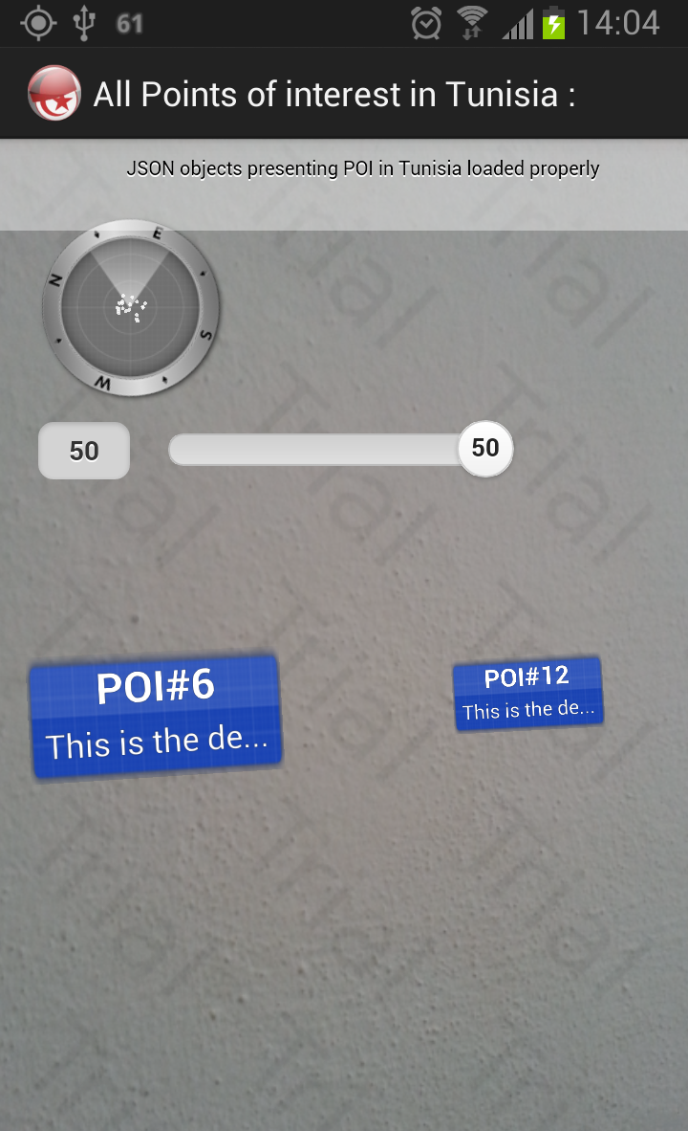
ACHIVEMENT

Slide 21
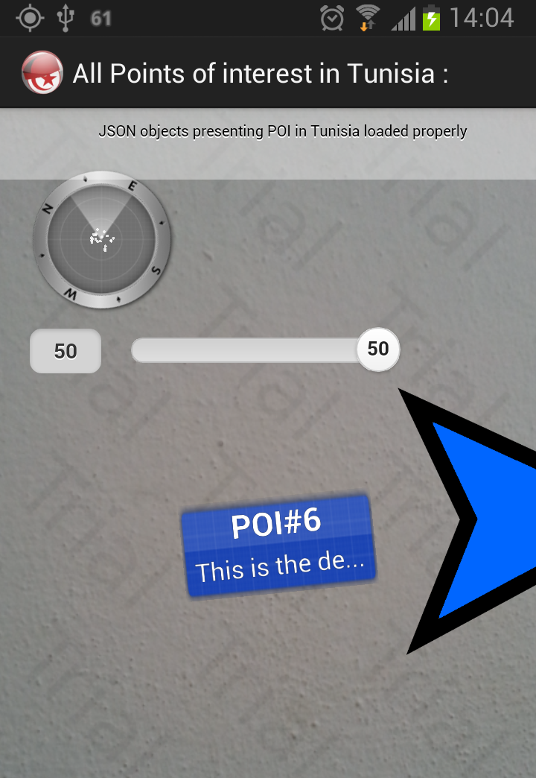
ACHIVEMENT

Slide 22
CONCLUSION & PROSPECTS
1
1
2
3
4
préalable
REQUIREMENTS
ARCHITECTUR
SOLUTIONS
Etude
OVERVIEW
TECHNOLOGIES
ASSESMENTS
DESIGN
ACHIEVEMENT
PROSPECTS
CONCLUSION
22

Slide 23
CONCLUSION & PROSPECTS
Integration with real data POIs for all interesting touristic places .
Adding commercialised options like booking rooms in hotels or bying things directly from the screen .
Extending informations about professionals and companies.
Improving the design of the application .
19

Slide 24
THANKS

